Slide 1
Unit :- 2 Process and Process Management

Slide 2
WHAT IS A PROCESS?
A process is a program in execution.
A process in execution needs resources like processing resource, memory and IO resource.
Imagine a program written in C – prog1.c.
After compilation we get an executable.
If we now give a command to run the program, it becomes a process.

Slide 3
WHAT IS A PROCESS?
A computer can have several process running or active at any given time.
In case of multiple users on a system, all users share a common processing resource.

Slide 4
MULTI-PROGRAMMING AND TIMESHARING
Let us consider a system with only one processor and one user running one program: prog_1.
IO and processing will happen alternately.
When IO is required, say keyboard input, the processor idles. This is because we are nearly a million times slower than the processor !!!

Slide 5
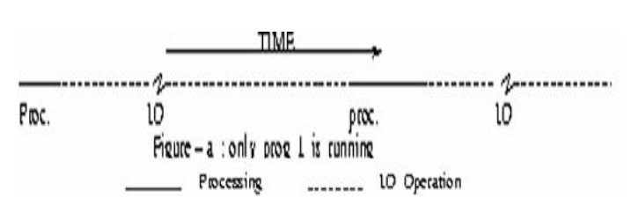
ONEPROGRAM-ONEUSER-UNI PROCESSOROPERATION
*Note: Most of the time the processor is idling !!

Slide 6
PROCESSOR UTILIZATION
What percentage of time are we engaging the processor?
Recall that for computing requires a program to reside in main memory to run.
Clearly, having just one program would result in gross under utilization of the processor.
To enhance utilization, we should try to have more than one ready-to-run program resident in main memory.

Slide 7
PROCESSOR UTILIZATION (CONT..)
A processor is the central element in a computer’s operation.
A computer’s throughput depends upon the extent of utilization of its processor.
Previous figure shows processor idling for very long periods of time when only one program is executed.
Now let us consider two ready-to-run memory resident programs and their execution sequence.

Slide 8
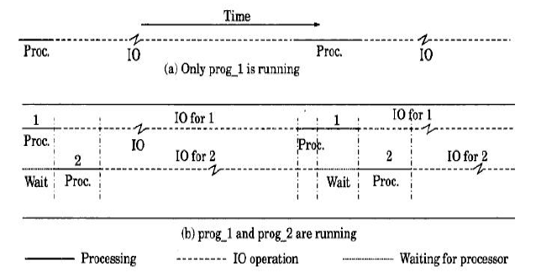
MULTI-PROGRAMMING SUPPORTINOS
Consider two programs : prog_1 and prog_2
resident in main memory.

Slide 9
MULTI-PROGRAMMING SUPPORTINOS (CONT..)
In the figure..
When prog-1 is not engaging the processor may be utilized to run another Ready-to-Run program.
Clearly these two programs can be processed without significantly sacrificing the time reouired to process either of them.

Slide 10
MULTI-PROGRAMMING SUPPORTINOS (CONT..)
Disadvantage -overhead faced while switching the context of use of the processor.
Advantage -computer resource utilization is improved.
Advantage –memory utilization is improved with multiple processes residing in main memory.
A system would give maximum throughput when all its components are busy all the time.

Slide 11
RESPONSE TIME
Consider the following scenario :
The number of ready-to-run programs must be maximized to maximize throughput of processor.
These programs could belong to different users.
A system with its resources being used by multiple users is called time sharing system.
For example, a system with multiple terminals. Also a web server serving multiple clients.

Slide 12
RESPONSE TIME
In case of a switch in the context of the use of the processor, we must know where in the program sequence the program was suspended.
In addition, intermediate results stored in registers have to be safely stored in a location before suspension.

Slide 13
RESPONSE TIME
When a large number of resident user programs compete for the processor resource, the frequency of storage, reloads and wait periods also increase.
If overheads are high, users will have to wait longer for their programs to execute =>Response Time of the system becomes longer.
Response Time is the time interval which spans the time from when the last character has been input to the time when the first character of the output appears.

Slide 14
RESPONSE TIME
In a time sharing system, it is important to achieve an acceptable response time.
In a plant with an on-line system, system devices are continuously monitored : to determine the criticality of a plant condition. Come to think of it even a library system is an on-line system.
If an online system produces a response time within acceptable limits, we say it is a real-time system.

Slide 15
IMPORTANT TERMS
Multiprogramming: A mode of operation that provides for the interleaved execution of two or more computer programs by a single processor.
Time Sharing: The concurrent use of device by a number of users.

Slide 16
CON..
Time Slice : The maximum amount of time that a process can execute before being interrupted.
PCB: The manifestation of a process in an operating system. It is a data structure containing information about the characteristics and state of process.

Slide 17
IMPORTANT TERMS
Swapping: Lifting the program from the memory to the disk & from the disk to the memory is known as Swapping.
CPU Utilization : We want to keep CPU as busy as possible means to maximize the usage of processor among the users.

Slide 18
CON..
Response Time : Response Time is the time interval which spans the time from when the last character has been input to the time when the first character of the output appears.
Throughput : It is the total volume of work performed by the system over a given period of time.

Slide 19
IMPORTANT TERMS
Turnaround Time : The interval from the time of submission of a process to the time of completion is measured as Turn-around time.
Waiting Time : The period spent waiting in the ready queue is measured as waiting time.

